Slide 1
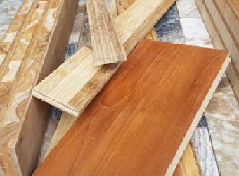
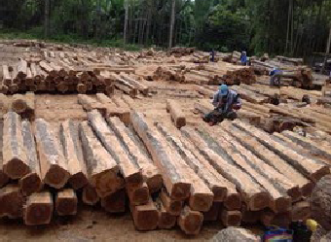
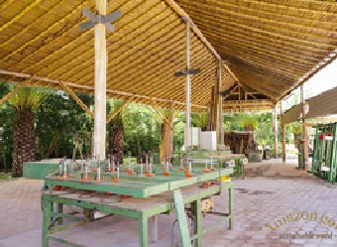
AMAZON GOLD – BIOLCOM
Biolcom’s wood products brand Amazon Gold is a CO₂ negative venture, conquer- ing world markets since 2002. Amazon Gold´s business relies on sustainable wood plantations. Amazon Gold teak farms have grown from selected seeds of mother trees, collected 32 years ago and are ready to be harvested sustainably and be converted into boards, beams, cross laminated products (CLT) and composite laminates for outdoor use. These products can be produced out of massive teak or combined with bamboo and balsa.
Amazon Gold´s factory located in Pifo Ecuador, well equipped with German and Swiss machinery, under palm trees and ecologic bamboo roof, is ready to receive your orders for custom made products.
ADDRESS
BIOLCOM
Pifo,
Francisco de Orellana 805 y Portugal. Quito, Ecuador
Phone: +593 993 403 767
marketing@biolcom.com www.teakfarmecuador.com
CONTACT
Mr. Peter Bachmann Phone: +593 999 552 911
gerencia@biolcom.com
IPD CONTACT
For more information please contact: Thomas Derstadt
IPD Expert Sourcing & Markets Phone + 49 (0) 228 909 00 81 82
derstadt@importpromotiondesk.de
PRODUCTS & QUANTITIES PER YEAR
+ Blockboard (5,000 m³ )
+ Decks, floors (5,000 m² )
+ Solid boards and desktops (5,000 m² )
+ Custom made office and reception desks
SOURCE OF RAW MATERIAL
+ Teak wood is 32 years old, 100% from sustainable own plantations
+ Bamboo is from sustainable plantations
MAIN MACHINERY
+ Saws
+ Presses
+ Planers
+ Lathe
+ Grinding
+ Drills
SPECIES
+ Teak (Tectona Grandis)
+ Bamboo (Guadua)
9
 Contents
ECUADOR

